Slide 1
Education and Economic Growth
- Korean Experience -
Post 2015 – MDG Seminar
March 5th, 2013
Oslo, Norway
Sun-Geun Baek, Ph.D
President, Korean Educational Development Institute (KEDI)
Professor, Department of Education, Seoul National University
President, Korean Society for Educational Evaluation
2013.3.5

Slide 2
1
Introduction
2
Korea: Yesterday and Today
3
Developmental phases of Korea and its Education System
4
Driving Forces of Educational Development
5
Toward Better Education : Future Tasks

Slide 3
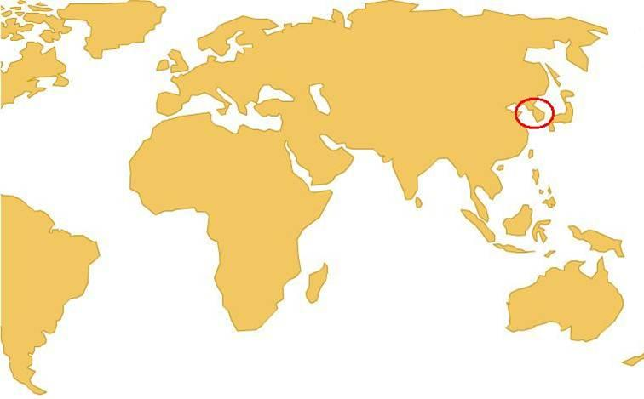
1
Introduction
▪ South Korea
Located in the eastern part of the Asian Continent
A five-thousand year history
A democratic state and a constitutional republic
South Korea
We are here!

Slide 4
1
Introduction
▪ South Korea
Since 1998, the Korean society has been characterized by the development of ICT-oriented industries, increased public welfare, openness, and globalization.
The current educational reforms have been directed towards enhancing public education, increasing accountability and autonomy of the schools, meeting the global standard, reducing private tutoring expenses, as well as building infrastructures for lifelong learning.

Slide 5
1
Introduction
▪ Education System in Korea
Korea has maintained a single-track 6-3-3-4 system, which requires 6 years of elementary school and 3 years of middle school as mandatory curriculum, and 3 years of high school as optional.
The enrollment rates in elementary, middle, and high schools have reached about 100 percent since 1994.
The percentage of high school students advancing onto a higher stage of education has reached 83.5 percent by 2008, which is one of the highest ratios in the world (KEDI,2009).

Slide 6
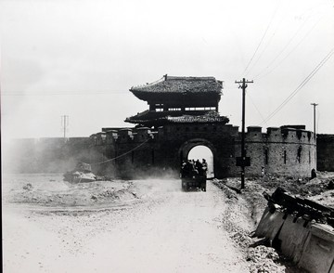
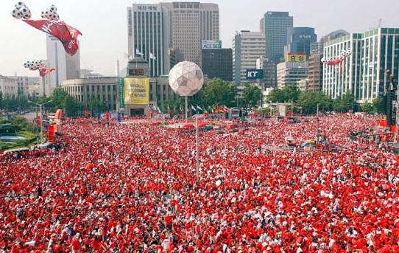
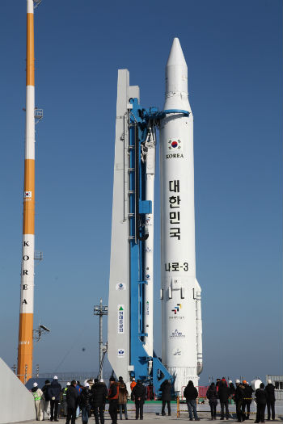
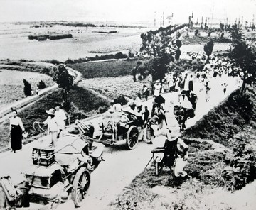
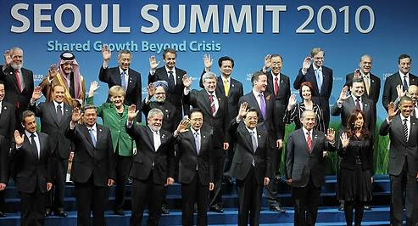
2
Korea: Yesterday and Today
<Korean War : 1950~1953>
<2002~2013>
▪ Once being one of the poorest countries, Korea is now a major trading and economic power in Asia as well as in the world.

Slide 7
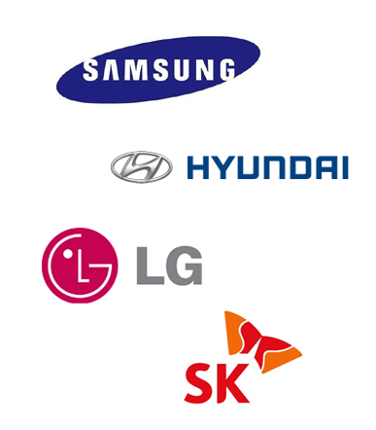
2
Korea: Yesterday and Today
▪ Korea ranked 8th in terms of the volume of international trade in 2012
▪ The 7th country in the world to join the 2050 club, which is for countries that have 20,000 dollars per capita and a population of 50 million

Slide 8
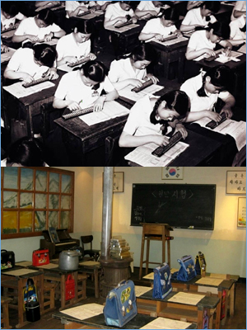
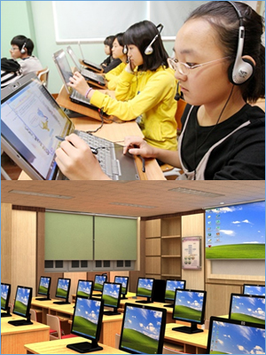
2
Korea: Yesterday and Today
▪ Classrooms & School Facilities
- The South Korea economy is currently the 15th largest economy in the world and the 3rd largest in Asia.
- Korea’s development is described as a ‘miracle,’ ‘unique,’ or sometimes ‘unusual.’

Slide 9
2
Korea: Yesterday and Today
▪ Achievements of Korean Education : Excellent Student Performance
- Thanks to our nation’s investment in education, Korea students have reached high levels of academic achievement in recent years.
PISA 2009
TIMSS 2007
*PISA(Program for International student Assessment) 2009 **TIMSS(Trends in International Mathematics and Science Study) 2007
* Since 2006 PISA, National Ranks has been announced with 95 % of significance level.

Slide 10
2
Korea: Yesterday and Today
▪ Achievements of Korean Education :
Excellent Student Performance & Skilled Manpower
Excellent Student Performance
Skilled Manpower
- ICCS (Institute for Citizen-Centered Service )
: Civic knowledge assessment among lower- secondary school students
(International average score: 500 points)
· No.1 Finland 576 points
· No.2 Denmark 576 points
· No.3 Korea 565 points
* Korea’s goal: true holistic education
- IVTC (International Vocational Training Competition)
· Champion for 9 consecutive years
· 2009, Calgary, Canada Competition No. 1
· Won 16 times in total
· No.3

Slide 11
3
Developmental Phases of Korea and its Education System
▪ Development phases of Korea (1945 ~ Present)
1st Phase
(1945-1960)
2nd Phase
(1961-1979)
3rd Phase
(1980-1997)
4st Phase
(1998-Present)
Independence
Korean War
Reconstruction
Globalization
Knowledge-Based Society
ICT Society
Industrialization
Urbanization
Democratization
Stabilized Economic Growth

Slide 12
3
Developmental Phases of Korea and its Education System
▪ 1st Phase : Independence, Korean War, Reconstruction (1945-1960)
Development Phase(Period) | 1st phase (1945-1960)
Phase of Manpower Supply | Literate and manually skilled workforce
Important Social Movement | Adult Literacy Campaign Establishment of Schools Universities by private donors
Phase of Education Development | Setting Basic Educational System Universal Primary Education
Policy Choices | Compulsory Education Reconstructing educational facilities

Slide 13
3
Developmental Phases of Korea and its Education System
▪ 1st Phase : Independence, Korean War, Reconstruction (1945-1960)
- The 6 year compulsory education policy (1954-1959)
<School Attendance Rate Among Elementary School-Age Children>
Year | Number of School Age Children | Number of Schooled Children | Ratio (%)
1953 | 3,096,293 | 2,259,313 | 72.9
1954 | 3,246,364 | 2,678,978 | 82.5
1955 | 3,289,865 | 2,947,436 | 89.5
1956 | 3,333,949 | 2,997,813 | 89.9
1957 | 3,480,225 | 3,170,981 | 91.1
1958 | 3,583,427 | 3,315,898 | 92.5
1959 | 3,689,690 | 3,558,142 | 96.4
1960 | 3,799,105 | 3,622,685 | 95.3
Source: Cheon-Seok OH 1974, 66 (Byeong-Seon Gwak. 2008. 15, Reused)
- Adult Literacy Campaign:
Adult illiteracy rate (78.0% in 1945->41.3% in 1948 -> 4.1% in 1958)

Slide 14
3
Developmental Phases of Korea and its Education System
▪ 2nd Phase : Industrialization, Urbanization (1961-1979)
Development Phase(Period) | 2nd phase (1961-1979)
Phase of Manpower Supply | Semi skilled & Skilled workforce
Important Social Movement | Saemaul Undong (New Community Development Movement)
Phase of Education Development | Universal Secondary Education Amplification of Vocational Education and Training
Policy Choices | Abolishment of the Middle School Entrance Exam High School Equalization Policy

Slide 15
3
Developmental Phases of Korea and its Education System
▪ 2nd Phase : Industrialization, Urbanization (1961-1979)
- 5-Year Economic Development Plan implemented in 1962
Linking educational process to economic development plans
- New Community Development Movement (Saemaul Undong)
- Expansion of Secondary Education
School-age population increases -> excessive competition and
private tutoring was sought to enter the nation’s best secondary schools
· Abolishment of the Middle School Entrance Exam(1969)
· High School Equalization Policy(1974)
- Expansion of Vocational Education & Training
· Vocational Training Law in 1967
· Central Vocational Training Institute was established in 1968
· Special Measure Law for Vocational Training enacted in 1974
-
-

Slide 16
3
Developmental Phases of Korea and its Education System
▪ 3rd Phase : Democratization, Stabilized Economic Growth (1980-1997)
Development Phase(Period) | 3rd phase (1980-1997)
Phase of Manpower Supply | Highly skilled & Educated workforce
Phase of Education Development | Mass Higher Education Pursuit of Education Substantiality
Policy Choices | July 30 Education Reform in 1980 Decentralized local autonomy of education

Slide 17
3
Developmental Phases of Korea and its Education System
▪ 3rd Phase: Democratization, Stabilized Economic Growth (1980-1997)
- July 30 Education Reform in 1980 / Expansion of Higher Education
· Lifted the control of university enrollment (Execution of the graduation quota system)
<Growth of University Enrollment, 1970-2010>
(The number of students)
1970 | 1975 | 1980 | 1985 | 1990 | 1995 | 2000 | 2005 | 2010
146,414 | 208,986 | 402,979 | 931,884 | 1,040,166 | 1,187,735 | 1,665,398 | 1,886,639 | 2,028,841
KEDI (2011). National Development through Education: Lessons from Korea. Brief Understanding of Korean Educational Policy, p.13.
- Decentralized local autonomy of education
- Operation Presidential Committee for Educational Reform (PCER)

Slide 18
3
Developmental Phases of Korea and its Education System
▪ 4th Phase : Globalization, Knowledge-Based Society, ICT Society (1998-present)
Development Phase(Period) | 4th phase (1998-present)
Phase of Manpower Supply | Knowledge/ICT workforce
Phase of Education Development | Globalization Enforcement of Educational Reformation and Competitive Power
Policy Choices | National HRD Policy Restructuring Higher Education (BK 21) Lifelong Education ICT

Slide 19
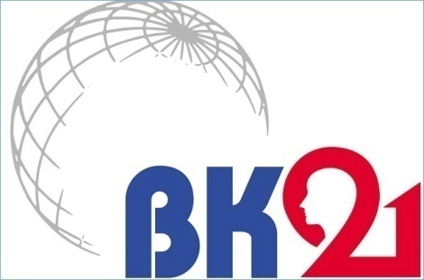
3
Developmental Phases of Korea and its Education System
▪ 4th Phase : Globalization, Knowledge-Based Society, ICT Society (1998-present)
- National Human Resource Development Network Policy
· Ministry of Education -> Ministry of Education and HRD
- Higher Education Reform
· The Brain Korea 21 Project
: To foster research-oriented graduate programs
· New University for Regional Innovation [NURI]
: To create specialization in regional universities
→ building regional community development
→ rise of the employment rate of local students
- Promoting Lifelong Learning (academic credit bank system)
· Aiming Open Education and Lifelong Learning
→ Recognize Various Qualification and Forms of Learning

Slide 20
3
Developmental Phases of Korea and its Education System
▪ A Framework of Educational & National Development
Educational Development
Improved Capacity at National, Regional, & Individual level
Improvement in Individual Abilities (change in knowledge, skills, & attitude)
Political, Economic, Socio-cultural Development

Slide 21
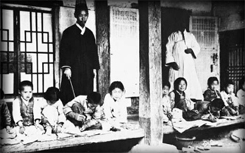
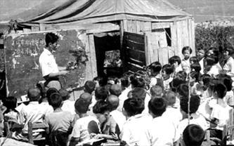
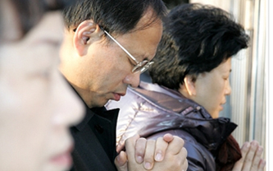
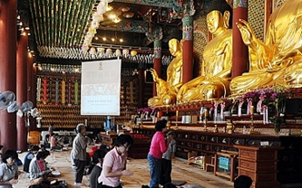
4
Driving Forces of Educational Development
▪ Interest and Passion for Education
- In Korea, education represents an investment in the future.

Slide 22
4
Driving Forces of Educational Development
▪ Government-led Education in Accordance with Economic Development
- National development strategy and education policies complementary
· 5-Year Economic Development Plan (1962)
· Cooperative and complimentary with educational development
- Education and policies managed systematically and strategically by the government
· Curriculum, Staffing, Budgeting, Educational Environment improvement etc.
- Increased Government education finance and steady Government’s education budget
· 78.47 billion KRW (1970) → 562.43 billion KRW (1990) → 35 trillion KRW (2008) · · Local Education Act(1963), and Local Education Finance Grant Act(1971)

Slide 23
4
Driving Forces of Educational Development
▪ Active Participation of the Private Sector in Education
- Government provided the private sector with financial incentives for the establishment of private schools
· Tax Exemption : Direct operation of private schools are waived.
· Public Subsidies : Tuitions for private schools- same level as of those for public schools
<Ratio of Private Schools>
 | 1965 | 1970 | 1975 | 1980
Middle School | 42.5% | 43.4% | 36.6% | 35.7%
High School | 45.1% | 47% | 49.2% | 51%
Compiled from KEDI (2009). Universalization of Elementary and Middle School Education. Understanding Korean Educational Policy, Vol. 4, p.66, p.73.

Slide 24
4
Driving Forces of Educational Development
▪ Excellent Teachers
- Attractive teaching job → High qualified students become teachers.
· Social image: Traditional respect for teacher:
→ Teachers are regarded as professionals
→ Traditional authority identified with that of the king
( ※ Trinity : King = Teacher = Father)
→ Required to have superior morality, integrity, and sincerity as models for the general public
- Job Security
· Legal status of public school teachers:
national civil servants → high status and job security
· Private school teachers: employees of each foundation; however,
enjoy same job security based on Private School Act
· Special Act on Improvement of Teachers’ Status: guarantees decent treatment and
compensation, employment of teachers
· Lifetime employment guarantee until retirement age (62) without license renewal

Slide 25
▪ Strategy 1: Sequential Approach
4
Driving Forces of Educational Development
A step-by-step approach (a bottom-up sequential approach) rather than
increment increase at all levels at the same time
Tertiary
High School
Middle School
Elementary School
Sequential Approach from Elementary → Tertiary
Step-by-step Approach
Quantity → Quality

Slide 26
4
Driving Forces of Educational Development
▪ Strategy 2: Egalitarian Approach & Low-cost Approach
Education for all ( ※ School Equalization Policy)
Lowering educational standards
Quantity expansion sacrificed quality (Quantity over quality)
Educational Equality
Education for All
Low-cost Approach

Slide 27
5
Toward Better Education : Future Tasks
Nurturing Global and Creative Talent
6 Main Tasks
For Cultivating
Creative and
Excellent
Human
Resources
Advanced Vocational Education
Universities that offer quality education
Global S&T HR Training
Strategic National R&D System
Globalization of education,
science and technology

Slide 28
References
Baek, S. G. (2010). Case Study on Korea’s Educational Assessment System. Paper presented at Seoul National University (SNU) International Conference for Education, Seoul, Korea.
Baek, S. G.(2009). Educational discourse on bright future, professor Baek’s one hundred education stories. Seoul: Kyo-yook Science Publishing Co.
- Korean Educational Development Institute & Ministry of Education, Science and Technology Republic of Korea. (2009). Secret of an Education Powerhouse, 60 Years of Education in Korea: Challenges, Achievements and the Future. Seoul: Sung-Yong Moon at al.
- Kwak, B. S.,&Jin, M. S.,& Kim, E. G.,& Lee, S. (2010). Educational Development in Korea: Strengths and Implications for Educational Reform. 2010 Policy Study. Seoul: Ministry of Education, Science and Technology.
- Lee, C. J.,& Kim, S.,& Adams, D. (Eds.). (2010). Sixty Years of Korean Education. Seoul: SNUPRESS.
Lee, S. J.(2008). National Development Strategy and Education Policy. Understanding Korean Education(1). Seoul: Korean Educational Development Institute.
Presidential Commission on Educational Reform (1995). Education reform plan for establishing new education system that leads globalization and information technology era. PCER.

Slide 29
Thank you!
Tusen takk!
www.kedi.re.kr
http://eng.kedi.re.kr

