Slide 1
Business Abroad – The Need for Qualifications
Stephen Sparkes
Vice President: Corporate Responsibility

Slide 2
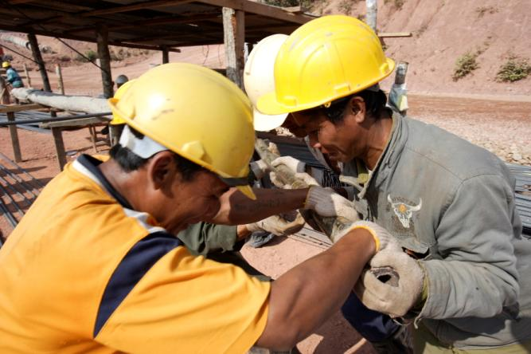
MDG and Hydropower Development
Potential employment opportunity for skilled, semi-skilled and non-skill labour force
Economic stimulus and job creation as a direct and indirect result of hydropower investment
Benefits to local and regional businesses and skills development

Slide 3
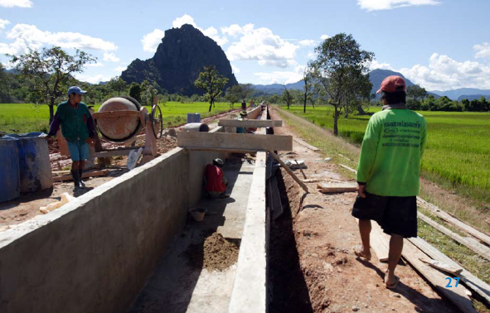
Challenges
Long period of preparation before an investment decision – little money available
Developers reliant on Contractors/sub-contractors
Local people “demand” employment
  How to find a solution given these three facts and requirements?

Slide 4
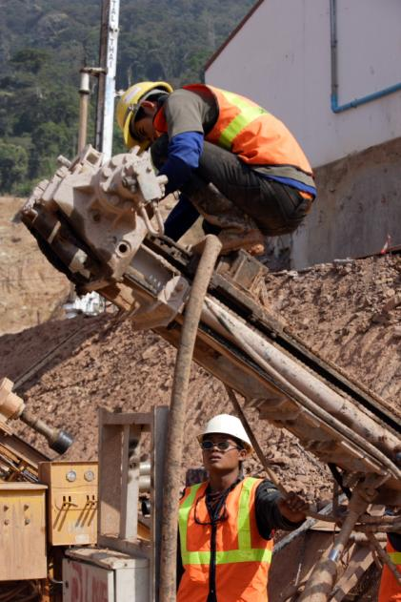
Practical Situation
Contractors prefer their own labour force that is efficient, experienced and loyal
CSR programs often start too late to include vocational training that can lead to construction jobs
Local workforce have local priorities and responsibilities – loyal to families and clans, or labour needs for agricultural work

Slide 5
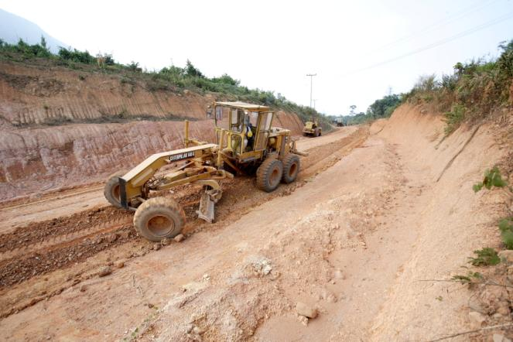
Possible Measures (1)
Principles and local laws referred to in Licenses
Inclusion of preferences for local workers in contracts – strong preferences but no percentage
Raise issues of local labour with contractors prior to mobilization
Work with government on rates and conditions

Slide 6
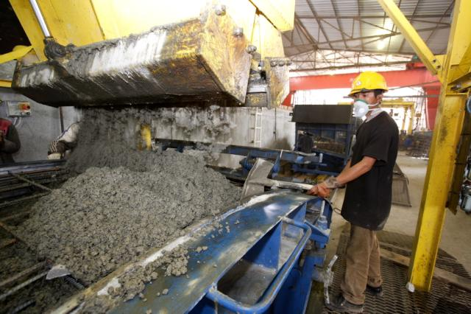
Possible Measures (2)
Assist government in compiling lists of qualified people for contractors
Establish recruitment offices with local authorities
Start training courses on practical skills for potential hire
  Carpentry and molding work
  Masonry and concrete work
  Welding
  Driving
  Language and accountancy skills

Slide 7
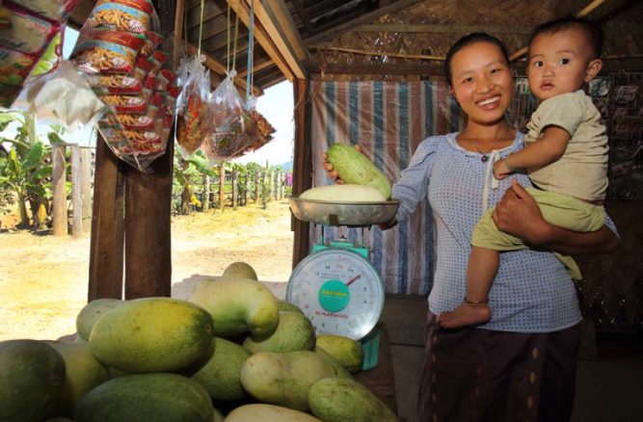
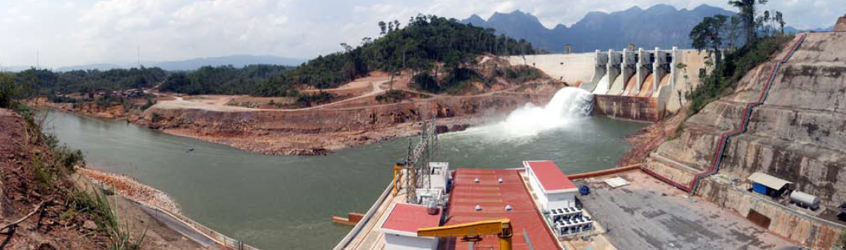
Possible Measures (3)
General long-term economic development in the region through job creation and opportunities
  Guards and manual labour requirements for camps
  Catering and supplies of food and essentials to camps
  Securing supplies from local businesses and entrepreneurs
Micro-credit support (mitigation)
Training of operation staff for long-term management

