Slide 1
Digital Disruption
Silvija Seres
27 september 2017

Slide 2
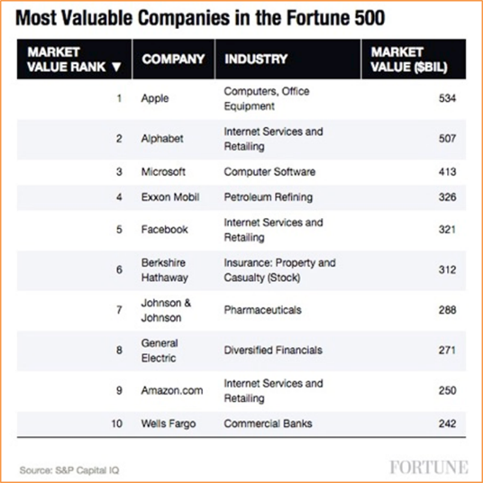
Tech rules the world. Software eats it.

Slide 3
The greatest disruption ever
This time is different:
Exponential
Polarising
Combinatorial

Slide 4
Exponential
Deceptive at first.

Slide 5
Polarising
Winner takes all.

Slide 6
Combinatorial
There are TWO sweet spots:
Digital marketplaces
Enabling technologies

Slide 7
12 Gutenberg moments at once
AI, big data
Robotics, automation
Biotech, bioinformatics, synthetic biology
Energy, smart cities and smart houses
3D printing, nanotech
Networks, sensors
Digital medicine
Fintech, regtech, edtech
VR and AR
Genetics
Transport and drones
Blockchain

Slide 8
Not here, not now, not so fast? Remember not to do linear transcriptions!

Slide 9
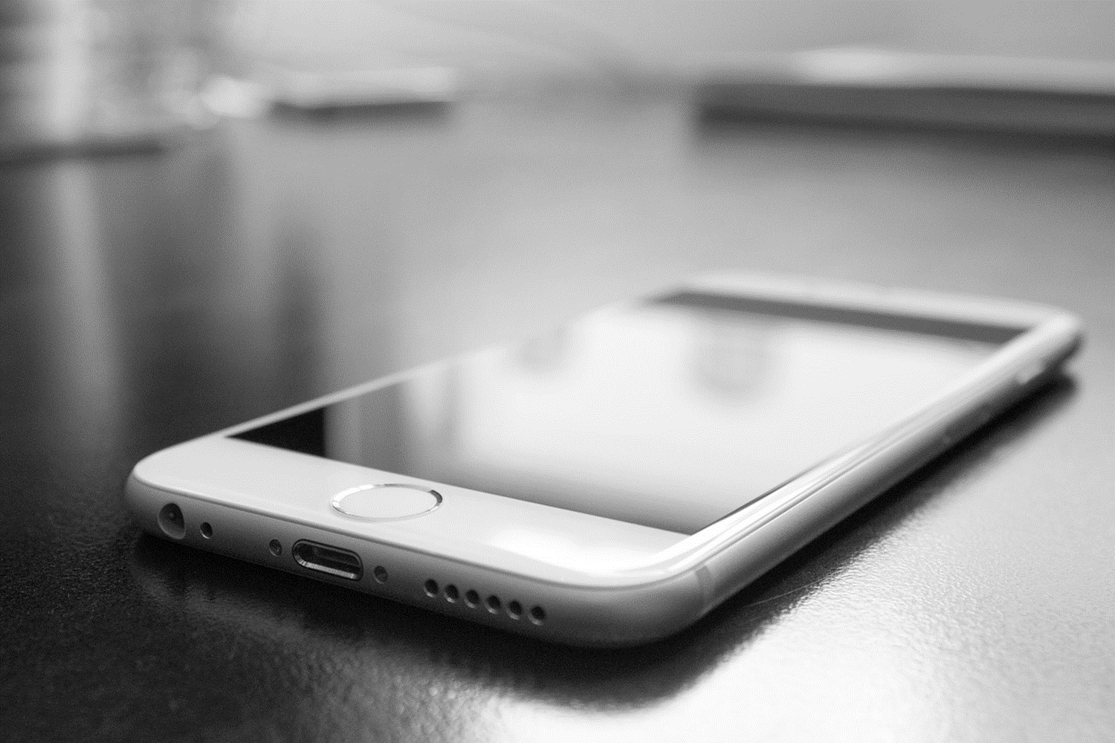
Incumbents on iPhone
Even with the Mac, Apple attracted a lot of attention at first, but they have remained a niche manufacturer. That will be their role in mobile phones as well. Nokia’s Chief Strategy Officer Anssi Vanjoki in 2009
We’ve learned and struggled for a few years here figuring out how to make a decent phone … PC guys are not going to just figure this out. Palm-CEO Ed Colligan in 2006
500 dollars? Fully subsidized? With a plan? I said that is the most expensive phone in the world. And it doesn’t appeal to business customers because it doesn’t have a keyboard. Microsoft’s CEO Steve Balmer, 2007

Slide 10
Incumbents on Amazon
Amazon.com is a very interesting retail concept, but IBM is already generating more revenue, and certainly more profit, than all of the top Internet companies combined. IBM CEO Lou Gerstner, 1999
The reality is it would be a daunting task requiring tens of billions of dollars in capital and years to build sufficient scale and density to replicate existing networks like FedEx FedEx CEO Mike Glenn, 2016

Slide 11
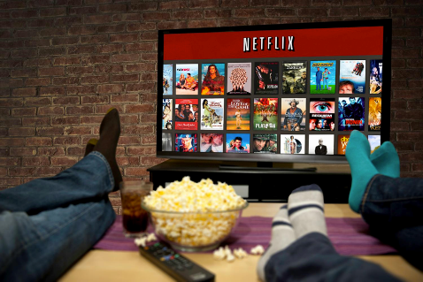
Incumbents on Netflix
Neither RedBox nor Netflix are even on the radar screen in terms of competition. Blockbuster CEO Jim Keyes, 2008
It’s a little bit like, is the Albanian army going to take over the world? I don’t think so. Time Warner CEO Jeffrey Bewkes, 2010
The notion that [companies like Netflix] are replacing broadcast TV may not be quite accurate. Alan Wurtzel, NBCU president of research and media development, 2016

Slide 12
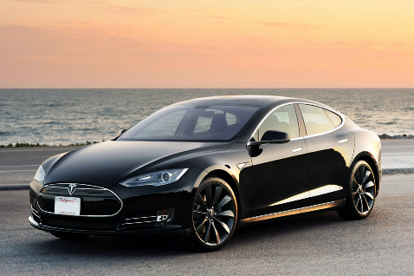
Incumbents on Tesla
If there were a rumour that Mercedes or Daimler planned to start building smartphones then they (Apple) would not be sleepless at night. And the same applies to me. Daimler CEO Dieter Zetsche, 2015
An iPhone belongs in your pocket, not on the road. Porsche CEO Oliver Blume i 2016

Slide 13
Norwegian examples
Telenor
Schibsted
Wilhelmsen
StormGeo
Ruter
NRK

Slide 14
Telenor: From local Telco to 7th largest mobile operator in the world.

Slide 15
Wilhelmsen: From shipping cars to defense logistics and port IT.

Slide 16
StormGeo: From weather media to energy derivatives

Slide 17
Ruter: From buses and trams to mobility services.

Slide 18
NRK: From orchestra and programming to production and distribution for democracy.

Slide 19
Social effects of digitalization
Polarisation
Algorithmisation
Globalisation

Slide 20
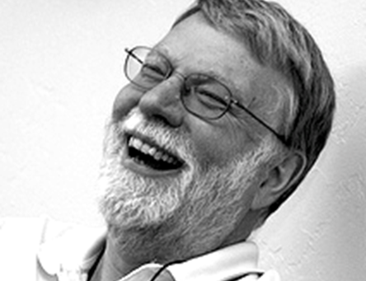
John Seely Brown
Halftime of a skill is down to 5 years.

Slide 21
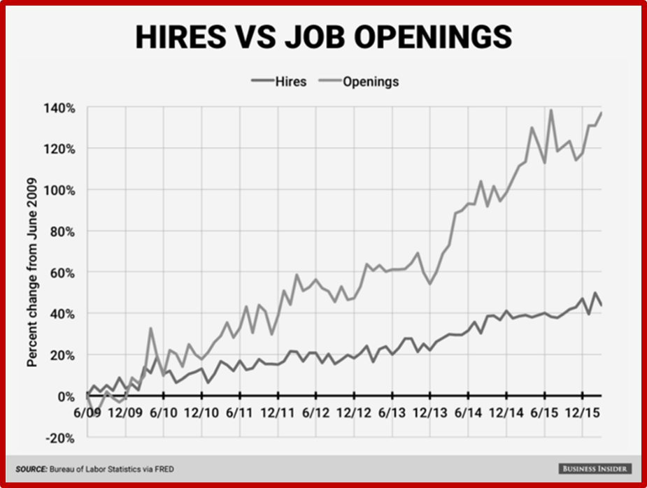
DOL gap
The growing skills gap!

Slide 22
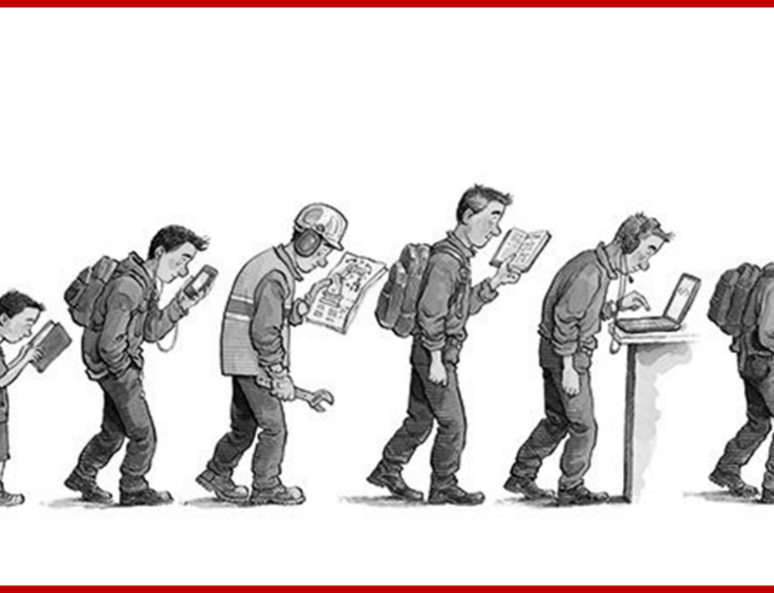
Economist & Lifelong Learning
When education fails to keep pace with technology, the result is inequality.

Slide 23
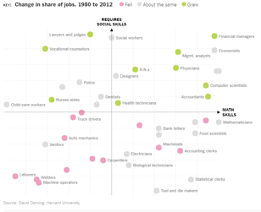
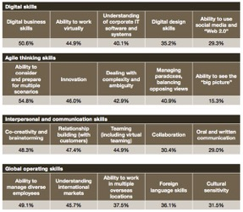
Future skillsets

Slide 24
Some reading ideas

Slide 25
Thank you, and good luck!
Questions: silvija.seres@gmail.com
Just fun: @silvijaseres
@silvijaseres

