Slide 2
Monitoring immigration detention policy and practice in Norway
Opportunities and dilemmas

Slide 3
Overview
Briefly about NOAS.
Monitoring detention policy and practice
Irregular entry
Procedural safeguards
Detention conditions
Forced returns
3. Lessons learned

Slide 4
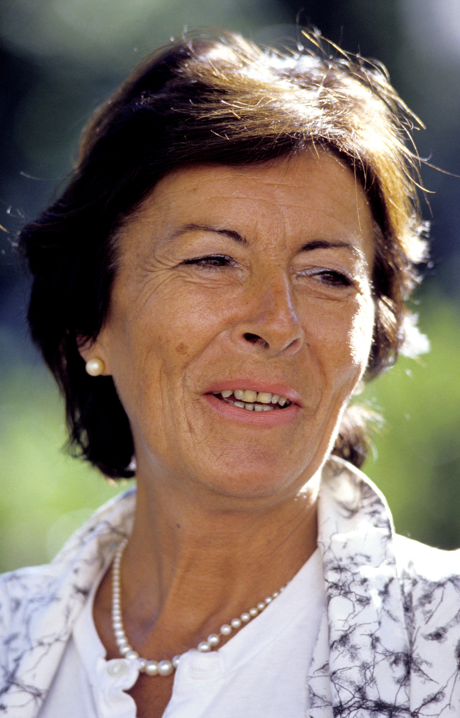
This is NOAS
Norwegian Organisation for Asylum Seekers
Founded by Annette Thommessen in 1984
Independent membership organization
Working for an asylum policy based on humanism, rule of law and international obligations
Foto: Finn E. Strømberg/ Aftenposten/ Scanpix
Notes:
What does it mean to be stateless?

Slide 5
NOAS’ work
Information and counseling for newly arrived asylum seekers
Legal aid
Advocacy
Police Immigration Unit
Registration
Directorate of Immigration
Asylum Interview
Directorate of Immigration
Decision
Lawyer
Appeal
Immigration Tribunal
Final decision
NOAS’ information and counseling programme
NOAS
Legal aid

Slide 6
Working in NOAS
8 persons in the information programme
13 persons in the main office
10-15 volunteers

Slide 7
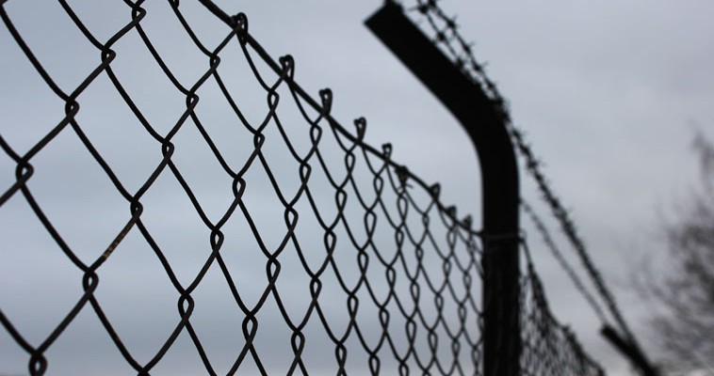
Monitoring immigration detention policy and practice

Slide 8
Irregular entry
The Convention relating to the Status of Refugees, 1951
Article 31
Refugees unlawfully in the country of refugee
1. The Contracting States shall not impose penalties, on account of their illegal entry or presence, on refugees who, coming directly from a territory where their life or freedom was threatened in the sense of Article 1, enter or are present in their territory without authorisation, provided they present themselves without delay to the authorities and show good cause for their illegal entry or presence.

Slide 9
asylum seekers
inform NOAS about the problem
NOAS contacts
Defense lawyers
Police
Director of public prosecutions
NOAS drafts a report (in English)
Identification of a suitable case for strategic litigation
Presentation by NOAS and academics to
Mainstream media
Authorities
Wider public
The report is presented to prominent legal academics in Norway and the IDC
A law firm takes the case pro-bono, NOAS as intervener
Contacting the UNHCR (amicus)
Supreme court decision
Follow-up
Notes:
Media skeptical at first.
Promotion of alternatives to detention: strategic litigation not possible.
Statelessness, non-application of Article 1D: report might be prepared by the UNHCR.

Slide 10
Opportunities
Contact with individual asylum seekers
Contact with defense lawyers and authorities
Cooperation with academics
Cooperation with the UNHCR
Cooperation with law firms
Good relationship with the mainstream media
Dilemma:
Approach to authorities: confrontation or cooperation?
Lesson learned: not really a dilemma – both strategies can be pursued simultaneously.

Slide 11
Issues pertaining to the correct application of procedural safeguards
Examples: detention of children and the principle of legal certainty; standard of proof; proportionality assessment; use of alternatives to detention; crime prevention grounds, etc.
Opportunities
Publication of reports (based on in-house research, utilisation of interested master students)
Meetings with representatives of the justice department, police, immigration authorities, political parties
Use of the media (often in cooperation with academics)
Dilemma
Litigation? By the time a case gets to the Supreme Court, the persons are deported and their case is dropped. Potential solution: use of international reporting mechanisms (WGAD, HRC, CERD, CRC)
Notes:
Only two alternatives to detention in Norway: an obligation to report and an obligation to stay in a specific place. Both alternatives may be combined with seizure of seizure of travel documents, tickets or other material items which may serve to clarify or prove identity.
Legislative amendment of the immigration law in 2012 – preponderance of evidence standard repealed. Instead: specific grounds for suspecting (konkrete holdepunkter for å anta). However, since January 2014, Dublin III requires “significant risk of absconding” Art. 28(2), cf. EU Returns Directive Art 15(1)(a), which only requires “a risk of absconding”.
The risk that authorization of detention may develop into a mere formality is real, as evidenced by the current situation in Denmark, see: UN Human Rights Council, Report of the Special Rapporteur on Torture and Other Cruel, Inhuman or Degrading Treatment or Punishment, Manfred Nowak : addendum : mission to Denmark, 18 February 2009, A/HRC/10/44/Add.2, para. 48.
Crime prevention grounds in paragraph 106 (d) of the Norwegian Immigration Act contravenes the recommendation by the European Agency for Fundamental Rights that domestic immigration laws should not regulate detention based on crime prevention.
WGAD is the only non-treaty-based mechanism whose mandate expressly provides for consideration of individual complaints.

Slide 12
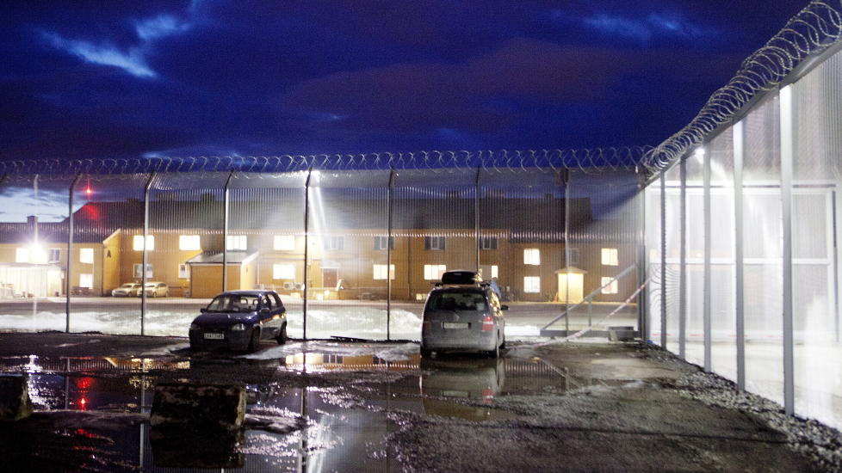
Detention conditions
Notes:
Capacity: 127 places plus 10 security cells.
Riots in March 2015: 50 persons. Windows were smashed and equipment destroyed
The detention centre has been criticised in 2012 by the UN Committee Against Torture (CAT) and the Committee for the Prevention of Torture (CPT) the for overcrowding and poor sanitary conditions. The conditions have been since improved, but use of detention continues to be on the rise.
The number of overnight stays at the detention centre:
2010: 7 431
2011: 17 874
2013: 28 470
The cost is almost 9 times higher than running an open reception centre.

Slide 13
Opportunities
NOAS has been allowed visits to the detention centre (each visit is subject to prior authorisation)
NOAS has a representative in the advisory committee of the National Preventive Mechanism under OPCAT
Dilemmas:
Should NOAS establish a regularised presence at the detention centre? (better oversight vs. loss of legitimacy)
Should NOAS advocate a model that is more like a regular prison (Denmark) or less like a regular prison (Sweden, Finland)?
Notes:
Relevant and competent national, international, and non-governmental organisations and bodies must have "the possibility to visit” the specialized detention facilities (such visits may be subject to authorisation), see EU Returns Directive art. 16 (4).
Several issues with visits by NOAS:
The visits are arranged beforehand
The authorities are in control of what is shown (bygg 40 not shown or described; nice sports equipment but the question is whether it is actually used…)
In Denmark: the detention centre is run by the correctional services (kriminal omsorgen).
In Sweden and Finland: detention centres are run by the Migration Board - social workers who are not authorised to use force.

Slide 14
Forced returns
Article 8(6), EU returns Directive:
“Member States shall provide for an effective forced-return monitoring system.”
At present, none of these fulfill the role of such system in Norway:
Parliamentary ombudsman (Sivilombudsmannen)
Supervisory Council for the detention centre
Ombudsman for Children
Equality and Discrimination Ombud
Dilemma:
- To what extent should NOAS be involved in monitoring of forced returns? (Danish model vs. Austrian model)
Notes:
NOAS foreslår at det opprettes en referansegruppe, eller rådgivende forum, der både organisasjoner, eksperter og myndighetsorganer deltar. Forumet er ment å fungere som et forum der deltakerne orienteres om praksisen for tvangsretur og tilsynet som føres med denne, og hvor de kan gi innspill og kommentarer til rapporteringen.
I Danmark har Ombudsmannen både rollen som forebyggende mekanisme og tilsynsrollen. I Østerrike er ombudsmannen forbyggende mekanisme etter OPCAT, mens en NGO fører tilsyn som påkrevd av returdirektivet. I begge land tolker den forebyggende mekanismen sitt mandat til også å dekke retten til å være med og observere på flygninger.

Slide 15
Thank you for attention

